Slide 1
OUR FUTURE TRIP TO TOKIO
TRAVEL PARTNERS: Imre Tercsi, Nikolett Füredi

Slide 2
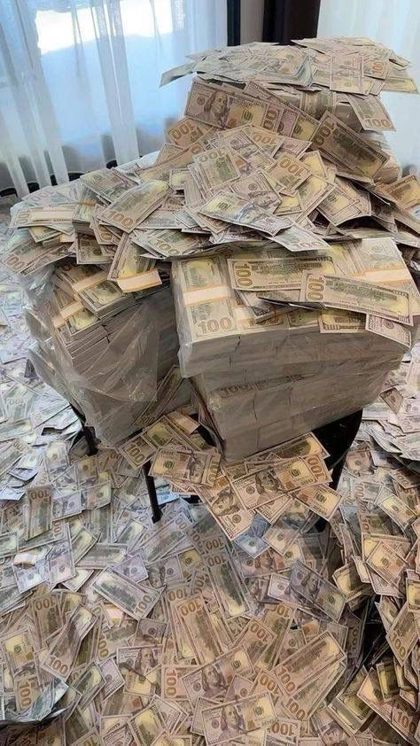
OUR BUDGET
1.200.000 FT

Slide 3
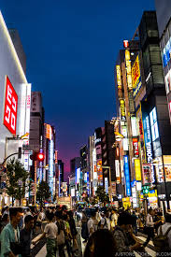
OUR DESTINATION
We chose Tokyo because we are interested in this culture and the life of the people there.
The choice wasn't difficult.
We will stay there for 4 days. (3 nights)

Slide 4
PREPARATION
Book a ticket.
Book accommodation.
Plan where we are going.

Slide 5
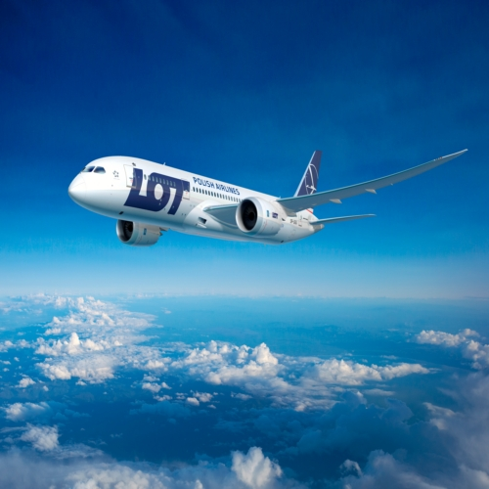
TRAVEL MEANS
Two tickets 311.900Ft
We are going by plane from Budapest airport.
A plane leaves Budapest at 2:45 PM, goes through Qatar, and arrives in Tokyo.

Slide 6
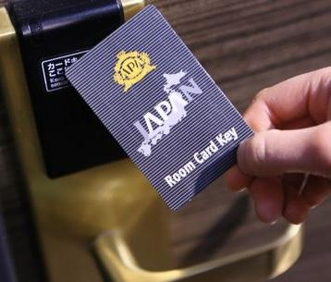
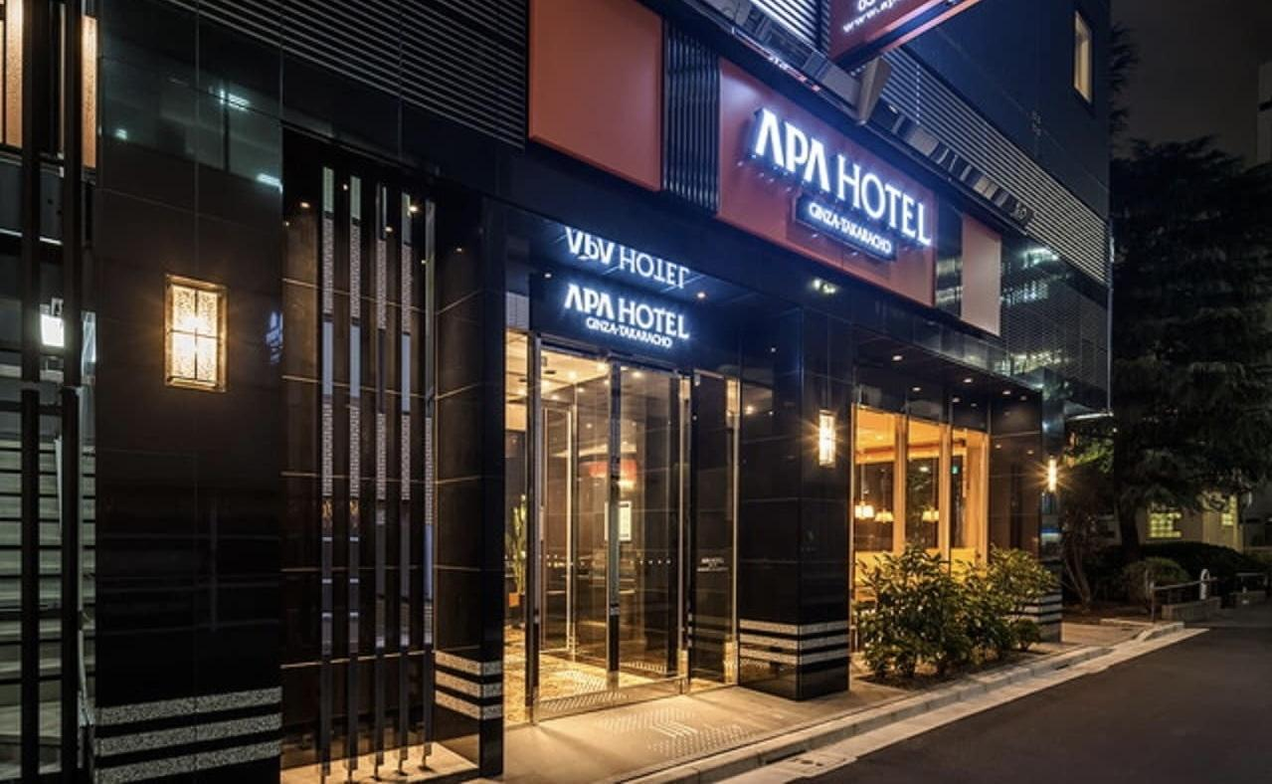
ACCOMMODATION
BUDGET INFO: 295. 000 Ft
We will be staying at APA Hotel Ginza Takaracho Tokyo Eki Yaesu Minamiguchi.
Breakfast and dinner are included in the price.
Instead of a key, they give you a card to enter the room.

Slide 7
ACTIVITIES
Imperial Palace, ticket 20.500Ft/ person
Car drifting in a parking, 33.000Ft/ person
2-hour night bike tour to the city's hidden gems,
15,500Ft/person
Open-top sightseeing bus with guide, 4.600Ft/ person

Slide 8
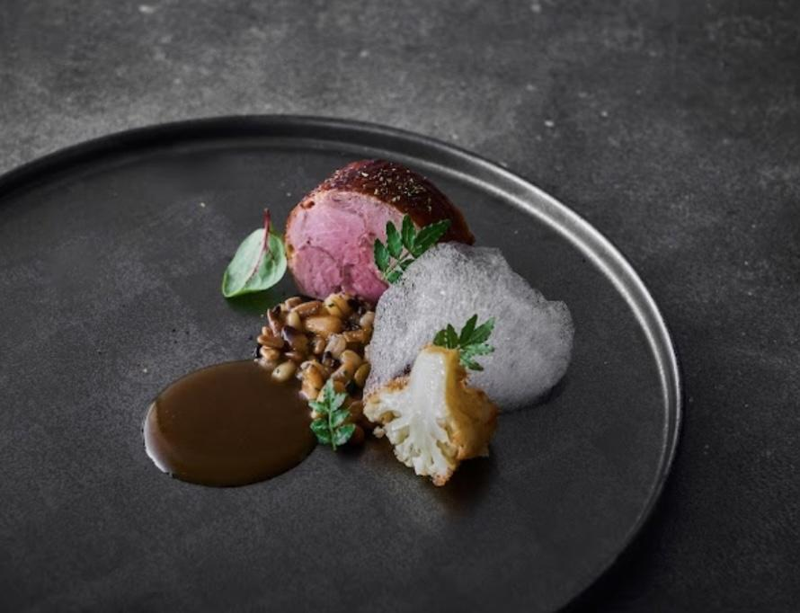
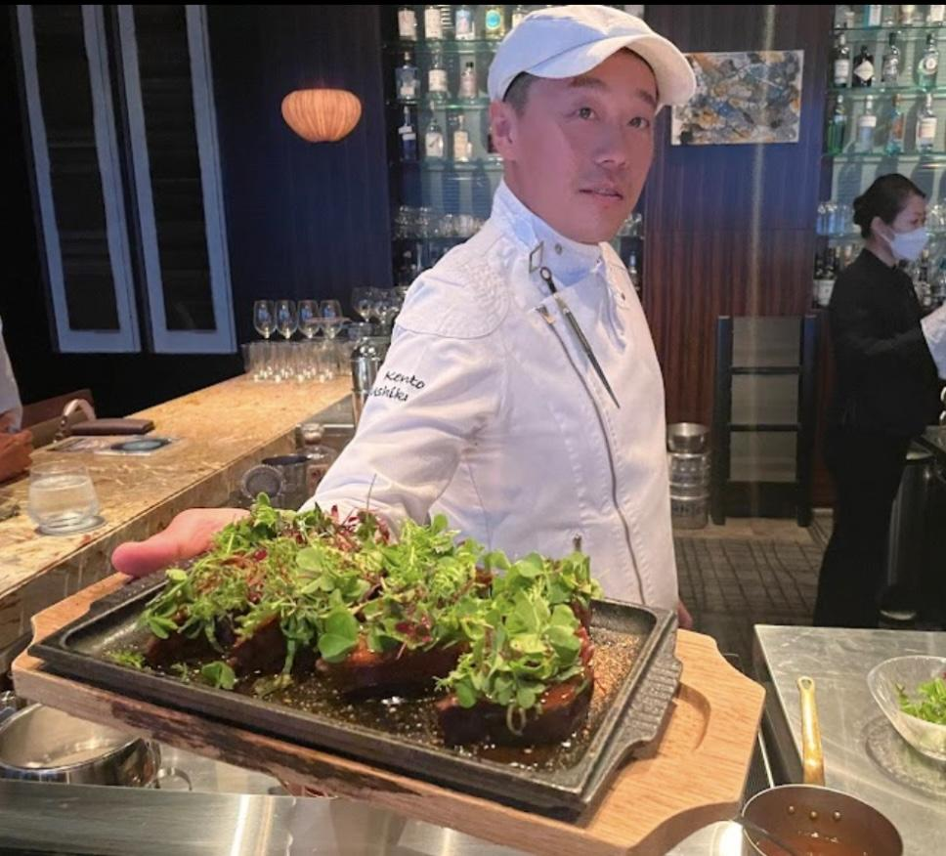
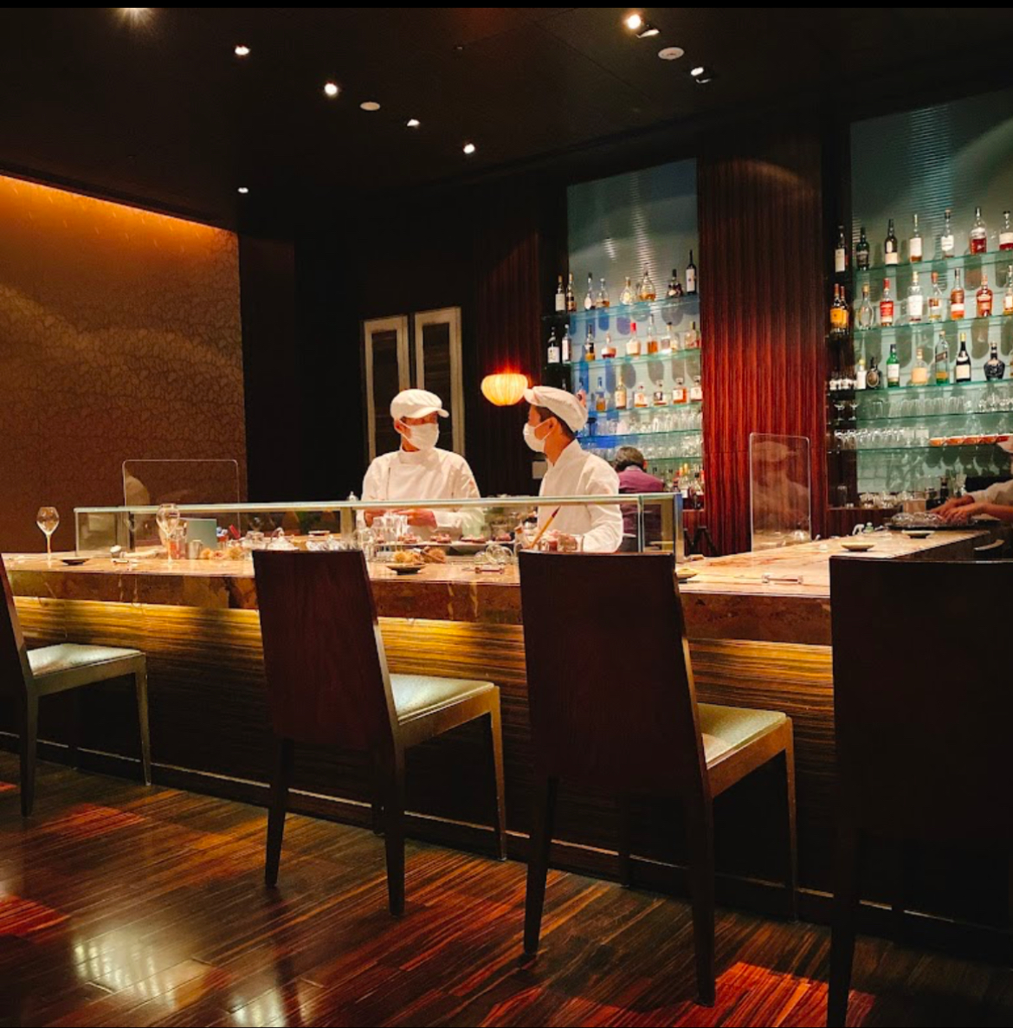
FOOD AND DRINK
On average
25.000 Ft/ person
Tapas Molecular Bar
This restaurant is truly exclusive, it has received 4.6 stars.
The exact location: 2 Chome-1-1 Nihonbashi Muromachi, Chuo City, Tokyo 103-8328, Japan

Slide 9
HARDSHIPS? POSSIBLE DIFFICULTIES?
We miss the plane.
The plane is late.
The language (Japan)
Transportation and navigation
Cultural misunderstandings
Weather
Foods and eating habits

Slide 10
BUDGET SUMMERY
TOTAL BUDGET:
959.100 Ft
Pre-travel costs
Reaching your destination | 311.900 Ft
Travelling at your destination | 5000 Ft
Accommodation | 295.000 Ft
Activities | 147.200 Ft
Food and drink | 200.000 Ft

