Slide 1
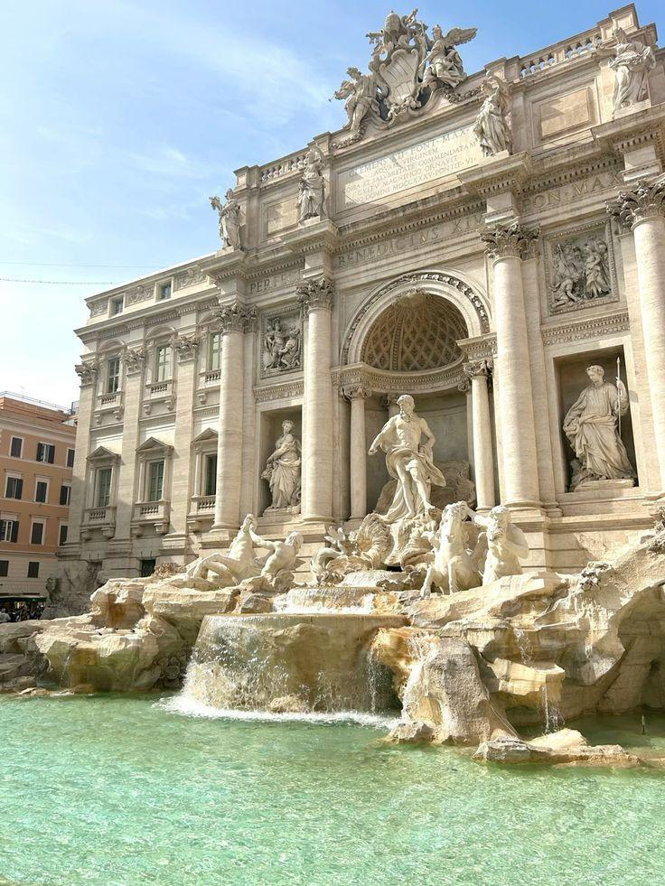
OUR FUTURE TRIP TO ROME
TRAVEL PARTNERS: Nagy Zsófia, Polyák László

Slide 2
OUR BUDGET
700.000 ft

Slide 3
OUR DESTINATION
Why did you choose this place?
Because this place is beautiful and spectecular.
How difficult was to reach a compromise?
It wasn’t difficult.
What did you take into consideration?
To be good for both of us.
How many days are you going to stay there?
4 days

Slide 4
PREPARATION - What documents / necessities do you need to get there? Do they have any costs?
BUDGET INFO: 15.000 ft
ID card
passport
train ticket

Slide 5
TRAVEL MEANS - How are you going to get there?
BUDGET INFO: Train=1000-1500 ft/person
Airplane=35.000 ft/person
Bus=3-day tourist pass is 10.000 ft/person
Train
Airplane
Bus

Slide 6
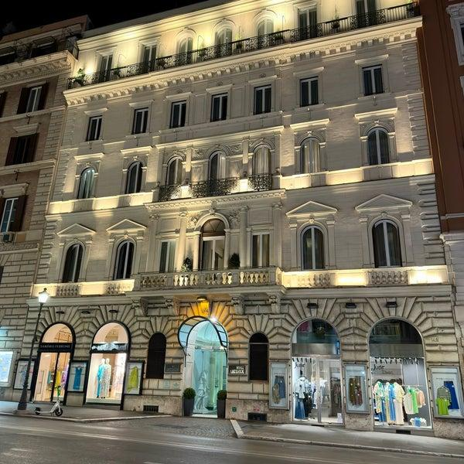
ACCOMMODATION - Where are you going to stay?
BUDGET INFO: 268.140 ft
In Hotel Artemide in the city center.
This place is near to the famous attractions.

Slide 7
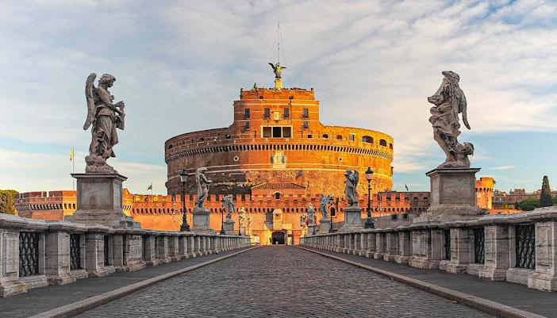
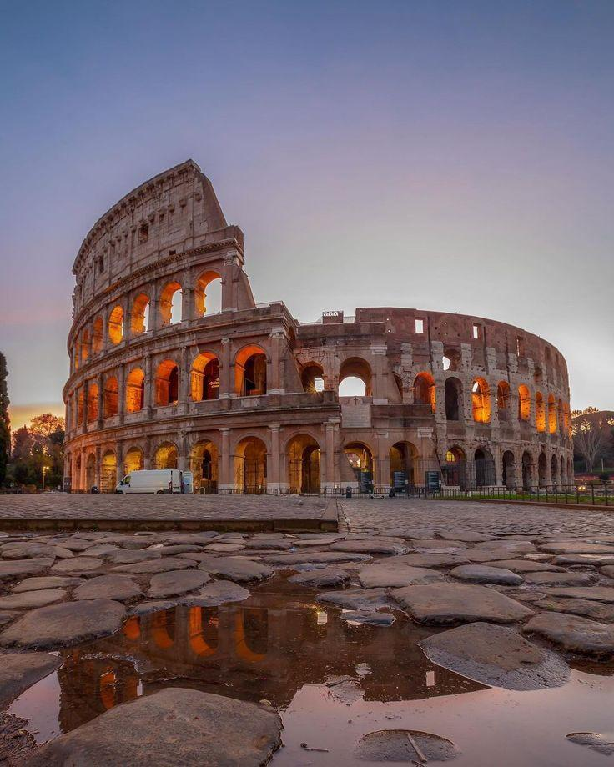
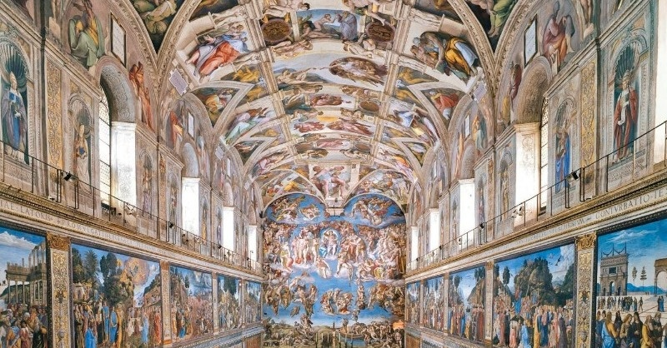
ACTIVITIES - What are you going to do? What sights are you going to see?
BUDGET INFO: 104.000 ft
Colosseum, Forum Romanum=25.000 ft/person
Vatican Museum, Sistine Chapel=15.000 ft/person
Castel Sant’Angelo= 12.000 ft/person
Trevi Fountain, Spanish Steps, Pantheon=Free

Slide 8
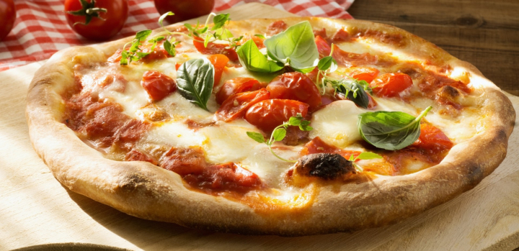
FOOD AND DRINK - What local dishes / drinks do you want to try?
BUDGET INFO: 5000 ft

Slide 9
BUDGET SUMMERY
TOTAL BUDGET: 530.140 ft
Pre-travel costs | 15.000 ft
Reaching your destination | 73.000 ft
Travelling at your destination | 20.000 ft
Accommodation | 268.140 ft
Activities | 104.000 ft
Food and drink | 50.000 ft

