Slide 1
OUR FUTURE TRIP TO EGER
TRAVEL PARTNERS: Doktor Ádám, Juhász Debóra

Slide 2
OUR BUDGET
⇨250.000 HUF

Slide 3
OUR DESTINATION
Why did you choose this place?⇨ Eger is beautiful and historic
How difficult was to reach a compromise? ⇨It was difficult,but we solved it
What did you take into consideration? ⇨budget,attractions
How many days are you going to stay there? ⇨ we stay 1 day

Slide 4
PREPARATION - What documents / necessities do you need to get there? Do they have any costs?
BUDGET INFO:
⇨personal ID
⇨driver’s license
⇨didn’t have to pay

Slide 5
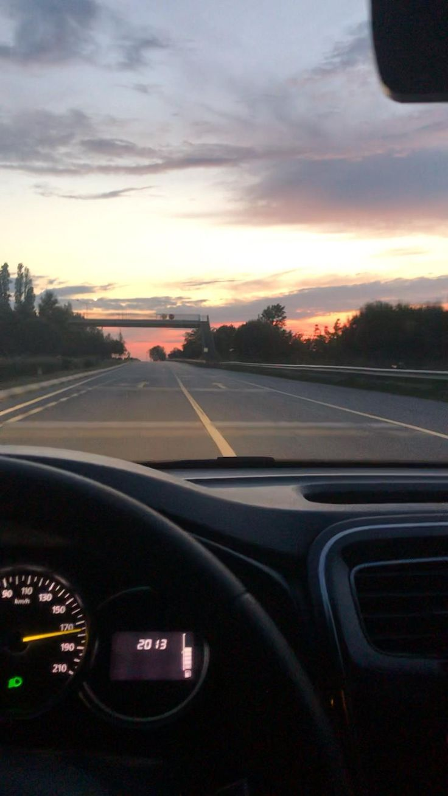
TRAVEL MEANS - How are you going to get there?
BUDGET INFO:
⇨Ádám will drive the car
⇨it’s about 300kilometers there and back
⇨its costs 25k

Slide 6
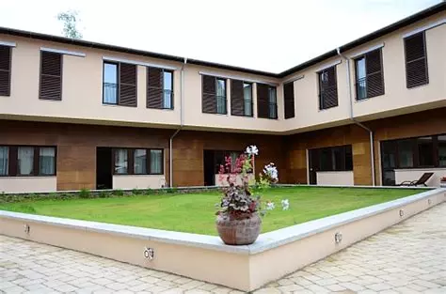
ACCOMMODATION - Where are you going to stay?
BUDGET INFO:
⇨we stay at Szent János hotel
⇨it costs 45k forints for 2 people

Slide 7
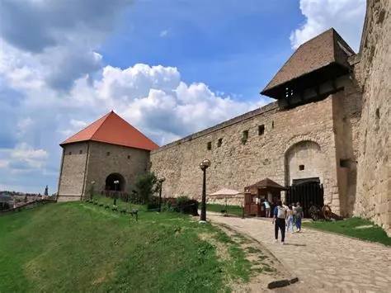
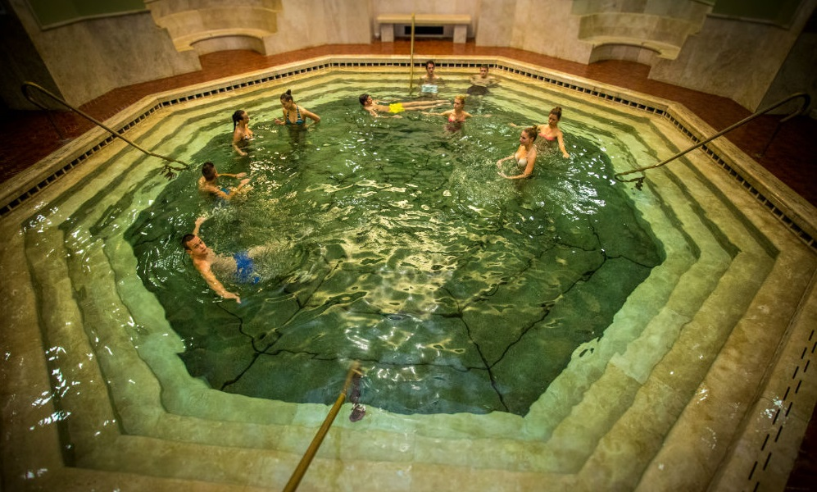
ACTIVITIES - What are you going to do? What sights are you going to see?
BUDGET INFO:
⇨ we going to see the Egri castle
it costs 6k for 2 people
⇨wine tasting in Szépasszony valley
it costs 20k for 2 people
⇨Thermal bath in Eger
it costs 6800 Forints for 2 people

Slide 8
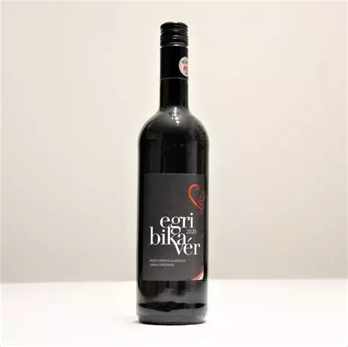
FOOD AND DRINK - What local dishes / drinks do you want to try?
BUDGET INFO:
⇨ we going to try egri bikavér
it costs 2k

Slide 9
HARDSHIPS? POSSIBLE DIFFICULTIES?
⇨Trafic problem

Slide 10
BUDGET SUMMERY
TOTAL BUDGET:
Pre-travel costs | 250k Forints
Reaching your destination | 25k
Travelling at your destination
Accommodation | 45k
Activities | 32.800Forints
Food and drink | 30k

